Slide 1
2025 DELEGATES

Slide 2
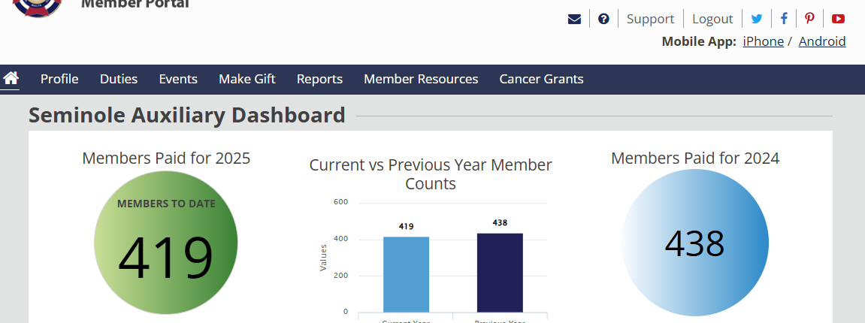
Department of Florida Bylaws - Auxiliary Entitled Delegates
Per Department of Florida Bylaws, each Auxiliary is entitled to one (1) Delegate and one (1) Alternate for every fifteen (15) members or fraction thereof as of the ‘Date of Election’ of delegates.
Notes:
Treasurers on the day of your Auxiliary April meeting pull
Membership # as shown in MALTA and Roster listing Active Members..

Slide 3
Number of Members used to Determine Entitled Delegates
Treasurers on the day of your Auxiliary April meeting log into MALTA to get the number of
Members Paid for 2025 – Members to Date
IN THIS EXAMPLE: the number of Members used to determine entitled Delegates for 2025 is 419
Notes:
Treasurers on the day of your Auxiliary April meeting pull
Membership # as shown in MALTA and Roster listing Active Members..

Slide 4
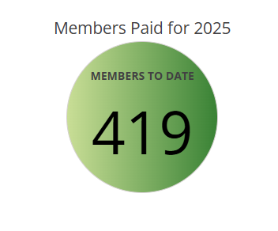
How to Calculate number of Delegates
One (1) Delegate and one (1) Alternate for every fifteen (15) members or fraction thereof
EXAMPLE:
419 divided by 15 = 27.93 (fraction thereof is .93) = 28 Entitled Delegates
Notes:
Treasurers on the day of your Auxiliary April meeting pull
Membership # as shown in MALTA and Roster listing Active Members..

Slide 5
How to Calculate Delegate Fees
Delegate fees are $5.00 per Delegate plus $5.00 for the Auxiliary President
(Fees are not required for Alternate Delegates)
EXAMPLE:
28 Entitled Delegates times $5.00 = $140.00
PLUS $5.00 for the Auxiliary President = 5.00
TOTAL DUE $145.00
Notes:
Treasurers on the day of your Auxiliary April meeting pull
Membership # as shown in MALTA and Roster listing Active Members..

Slide 6
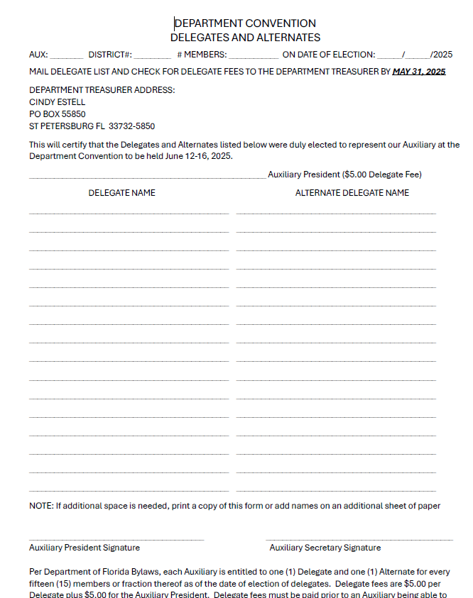
2025 Delegate List
The Delegate list MUST include the names for the auxiliary entitled Delegates and the same number of Alternate names.
The current Auxiliary President name is to be included on the Auxiliary President line.
In our Example: This Delegate list would include 28 Delegate names and 28 Alternate Delegate names.

Slide 7
2025 Delegate Form
The 2025 Delegate form can be found in the Dept of Florida VFW Auxiliary website (www.vfwauxfl.org) under Resources/Treasurer and Trustee

Slide 8
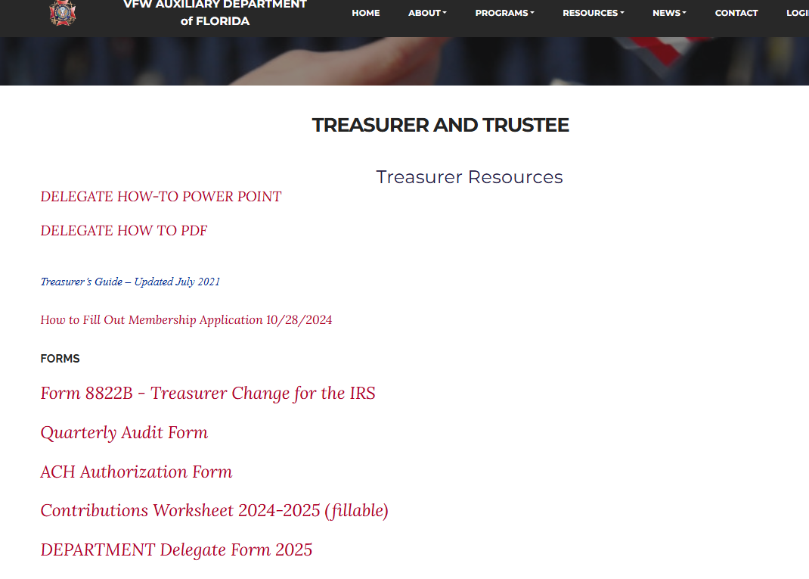
2025 Delegate Form
The 2025 Delegate form can be found in the Dept of Florida VFW Auxiliary website (www.vfwauxfl.org) under Resources/Treasurer and Trustee

Slide 9
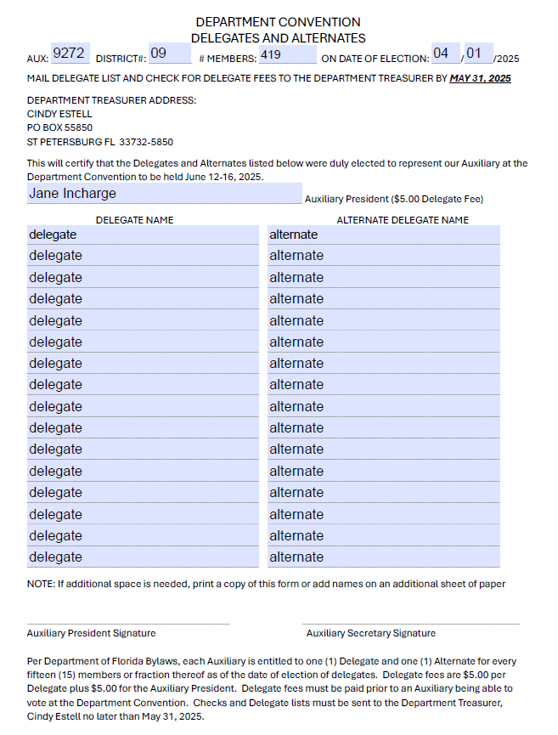
2025 Delegate List
The Delegate list MUST include the names for the auxiliary entitled Delegate and the same number of Alternate names.
The current Auxiliary President name is to be included on the Auxiliary President line.
In our Example: This Delegate list would include 28 Delegate names and 28 Alternate Delegate names.
NOTE: A second page will be completed to include the additional Delegate and Alternate names

Slide 10
FINAL STEP
Checks must be made payable to: ‘VFW Auxiliary’ and mailed with the completed Delegate List(s) to the Department Treasurer no later than MAY 31, 2025, at the following address:
CINDY ESTELL
PO BOX 55850
ST PETERSBURG FL 33732-5850
April 25, 2025
VFW AUXILIARY
XXX.XX
“EXAMPLE ONLY”
2025 Delegates
Auxiliary Treasurer
Notes:
Treasurers on the day of your Auxiliary April meeting pull
Membership # as shown in MALTA and Roster listing Active Members..

